Slide 1


Mothership-Glider Interfacing
7
Team Trident, Team 7

Slide 2
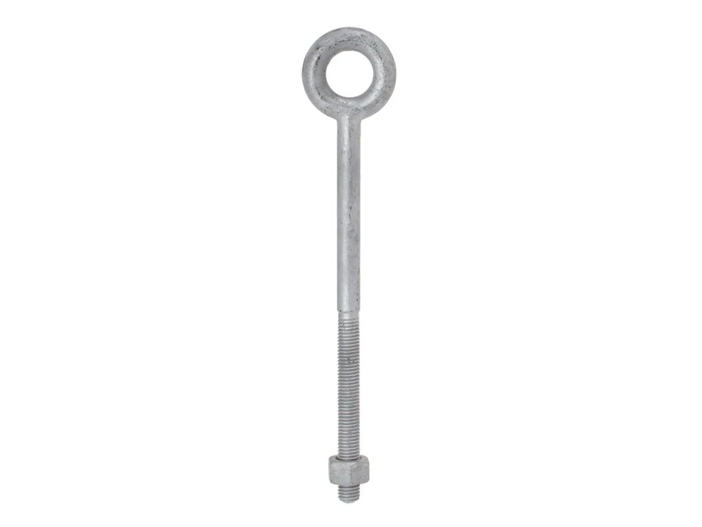
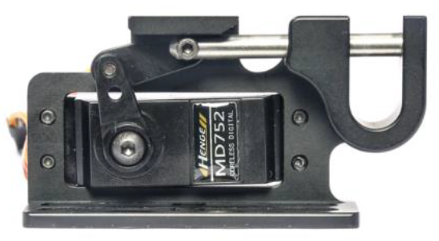
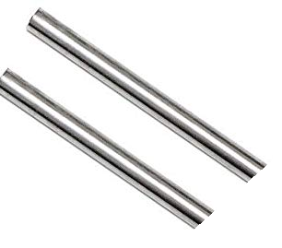
Release mechanism

Slide 3
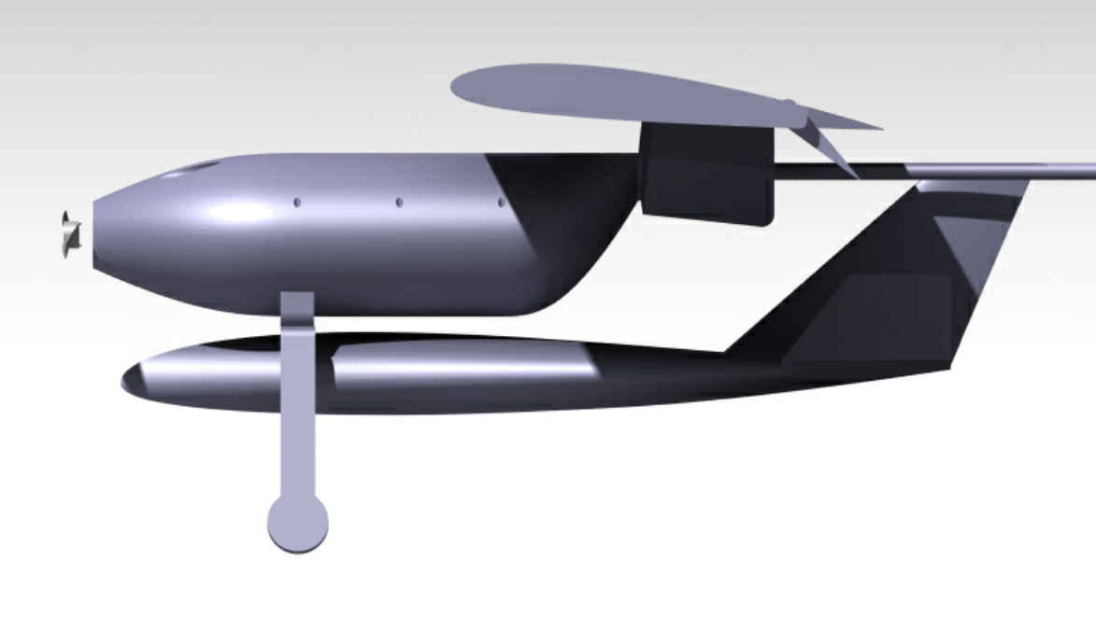
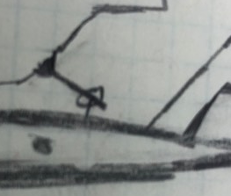
Configuration
1 servo at the front
2 rods at the back
(top view) pin opening to the aft

Slide 4
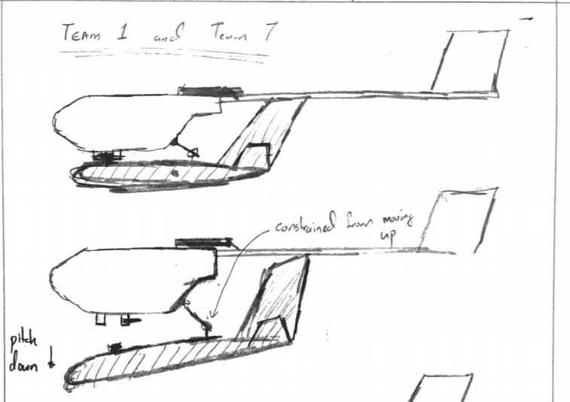

Slide 5
